Slide 1
Assignment 3
Your name: Yang Zhang
Your GTID: 903421882

Slide 2
Visualization

Slide 3
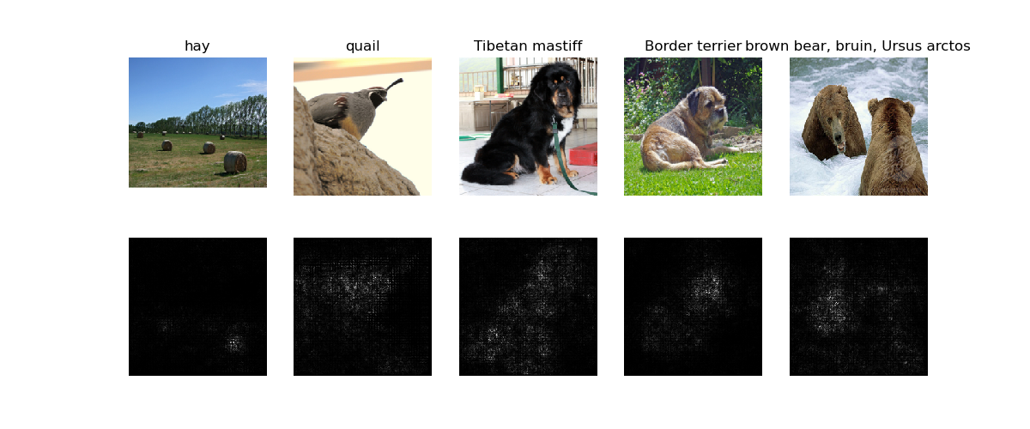
Saliency Map (1 point)
Include your saliency map here

Slide 4
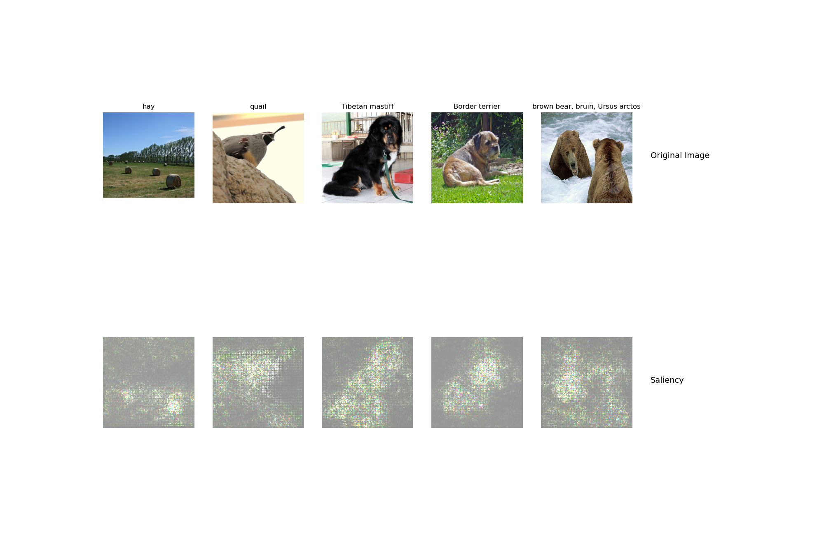
Saliency Map Captum (1 point)
Include your saliency map from Captum here

Slide 5
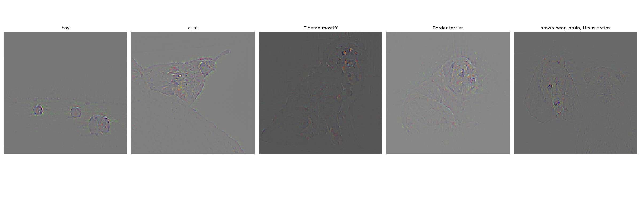
Guided Backprop (1 point)
Include your visualization of Guided Backprop here

Slide 6
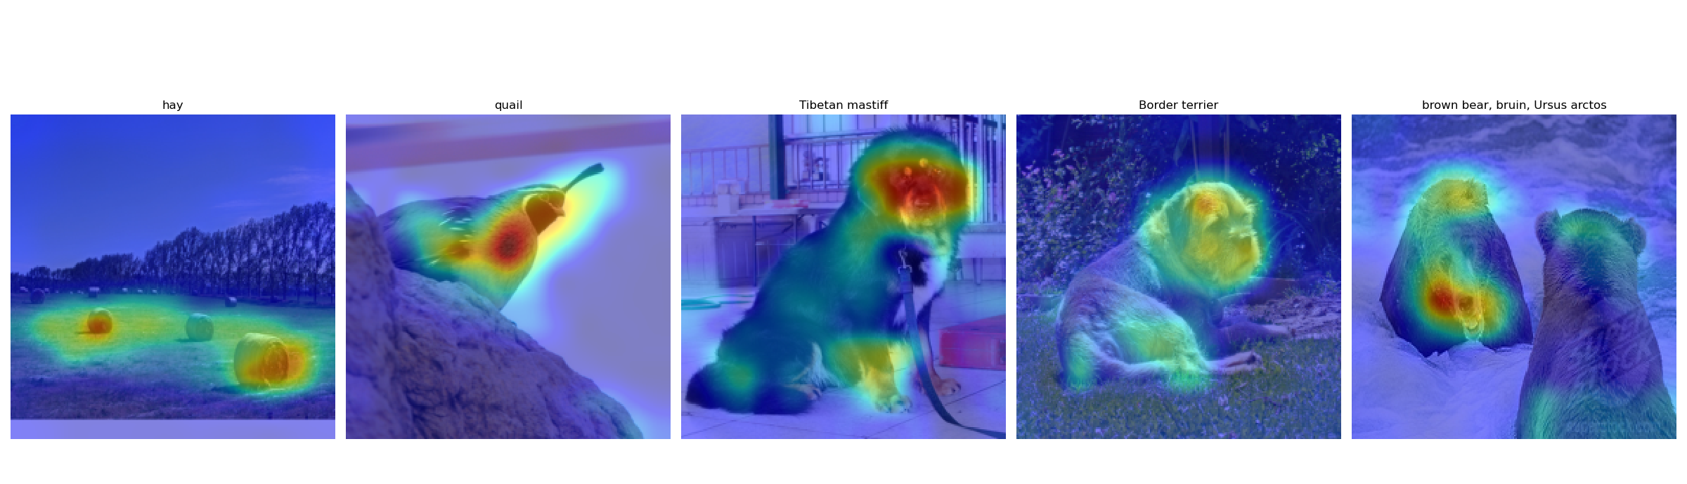
GradCam (1 point)
Include your visualization of GradCam here

Slide 7
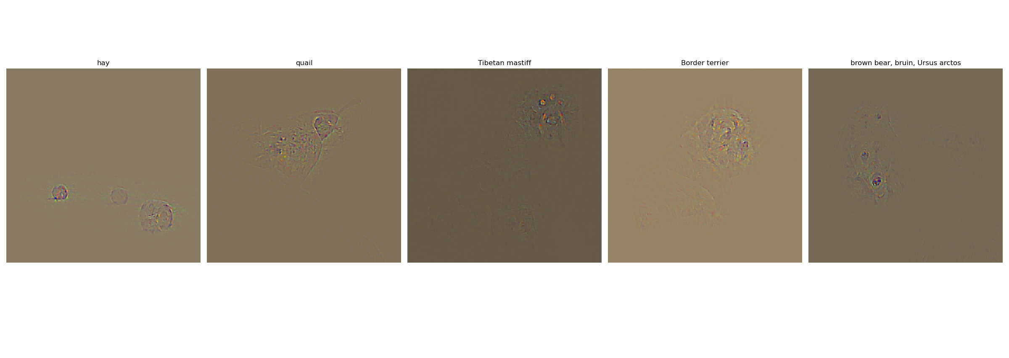
Guided GradCam (1 point)
Include your visualization of Guided GradCam here

Slide 8
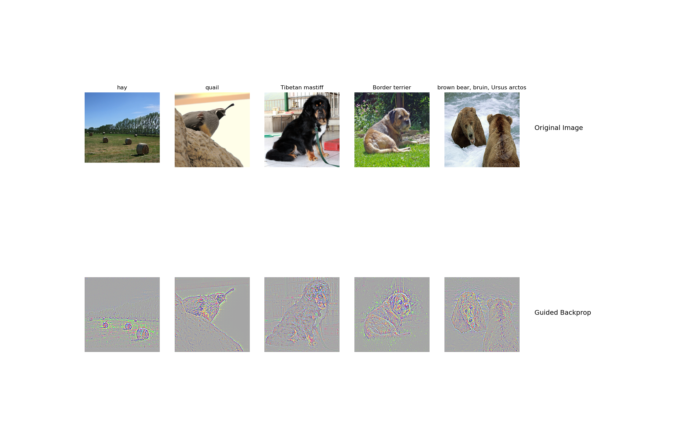
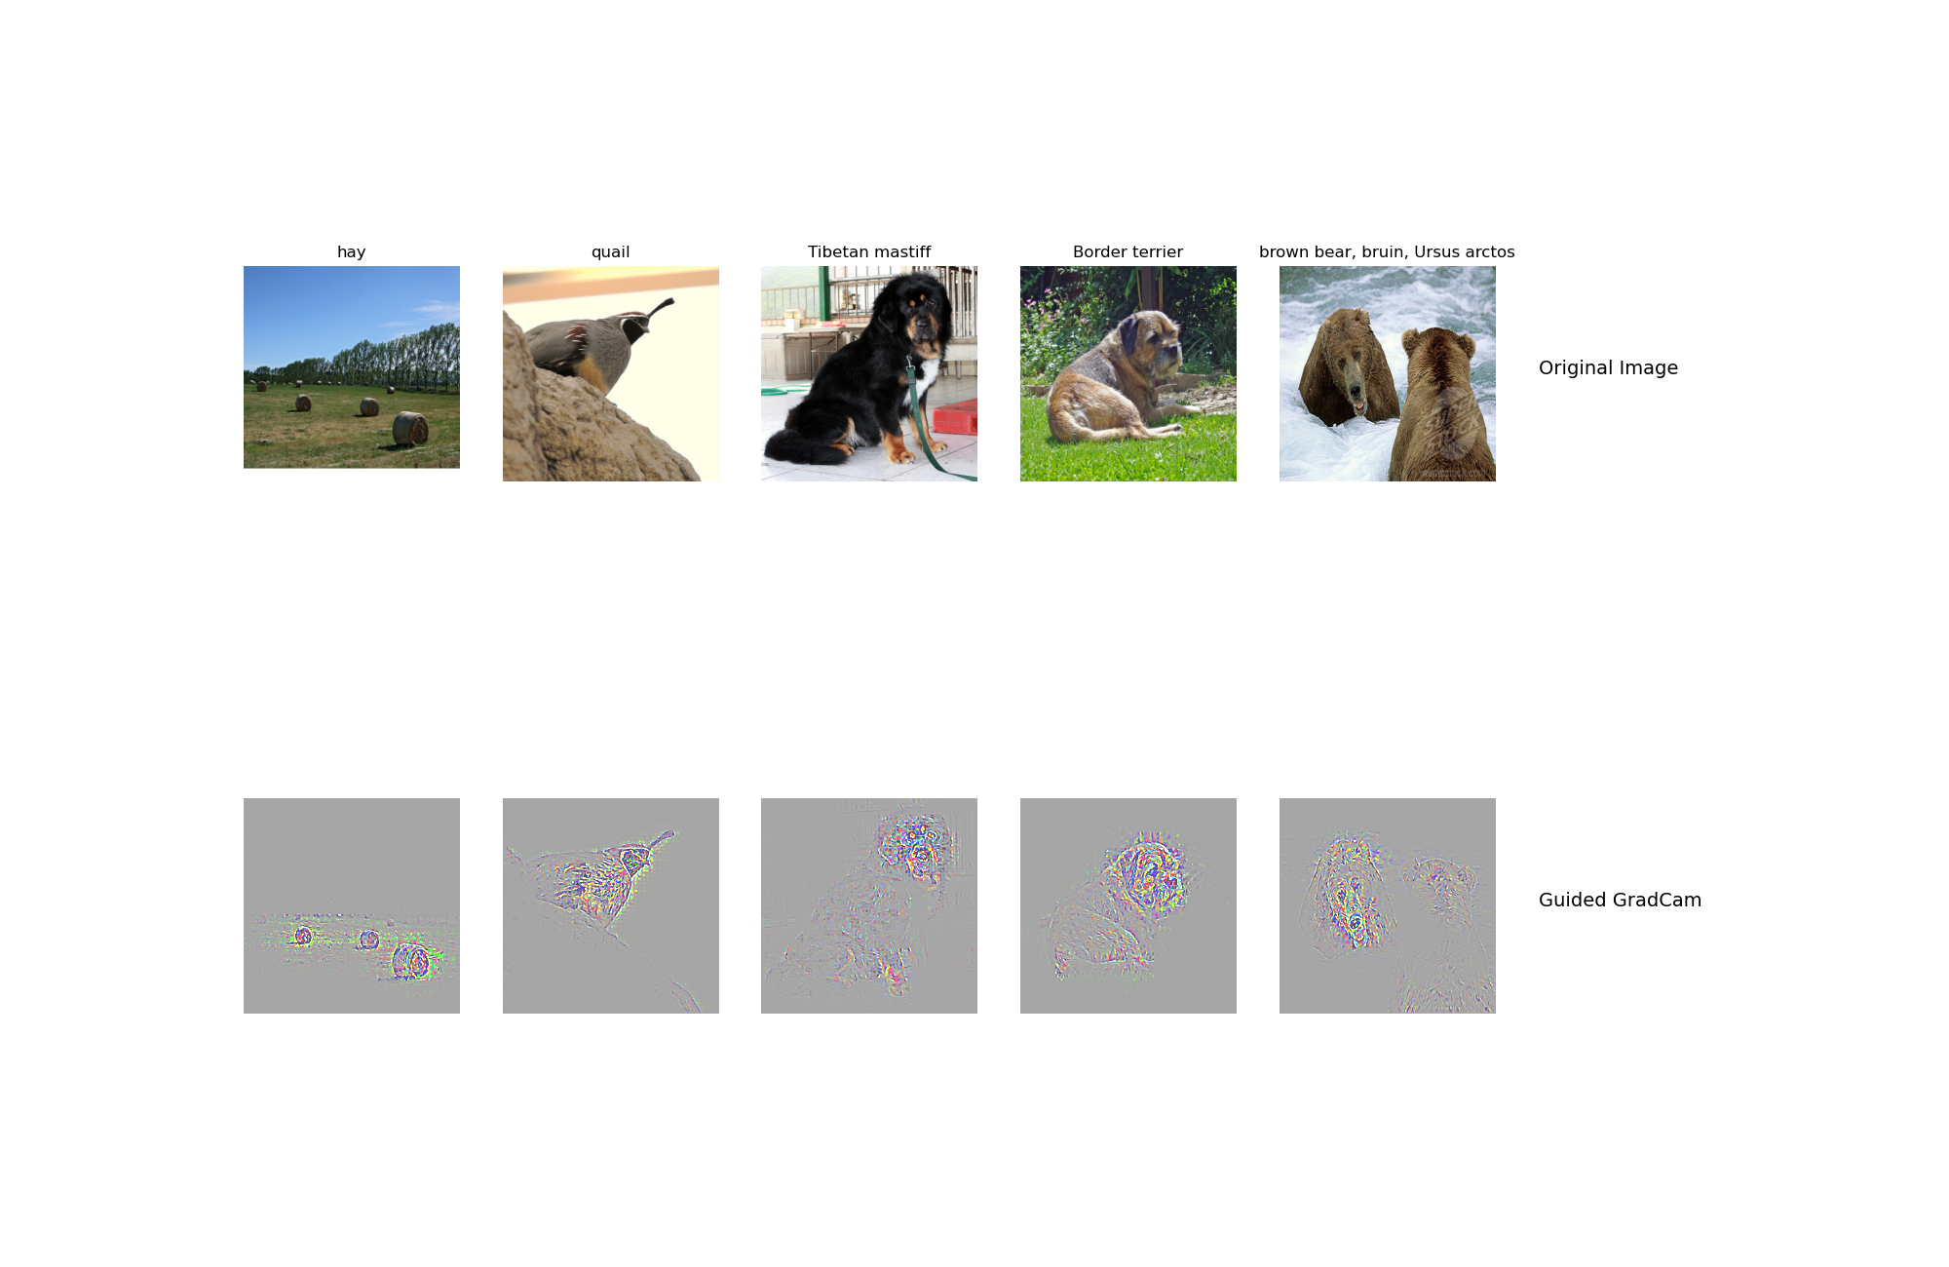
Guided Backprop + GradCam (Captum) (1 point)
Include your visualization of Guided Backprop and Guided Gradcam from Captum here

Slide 9
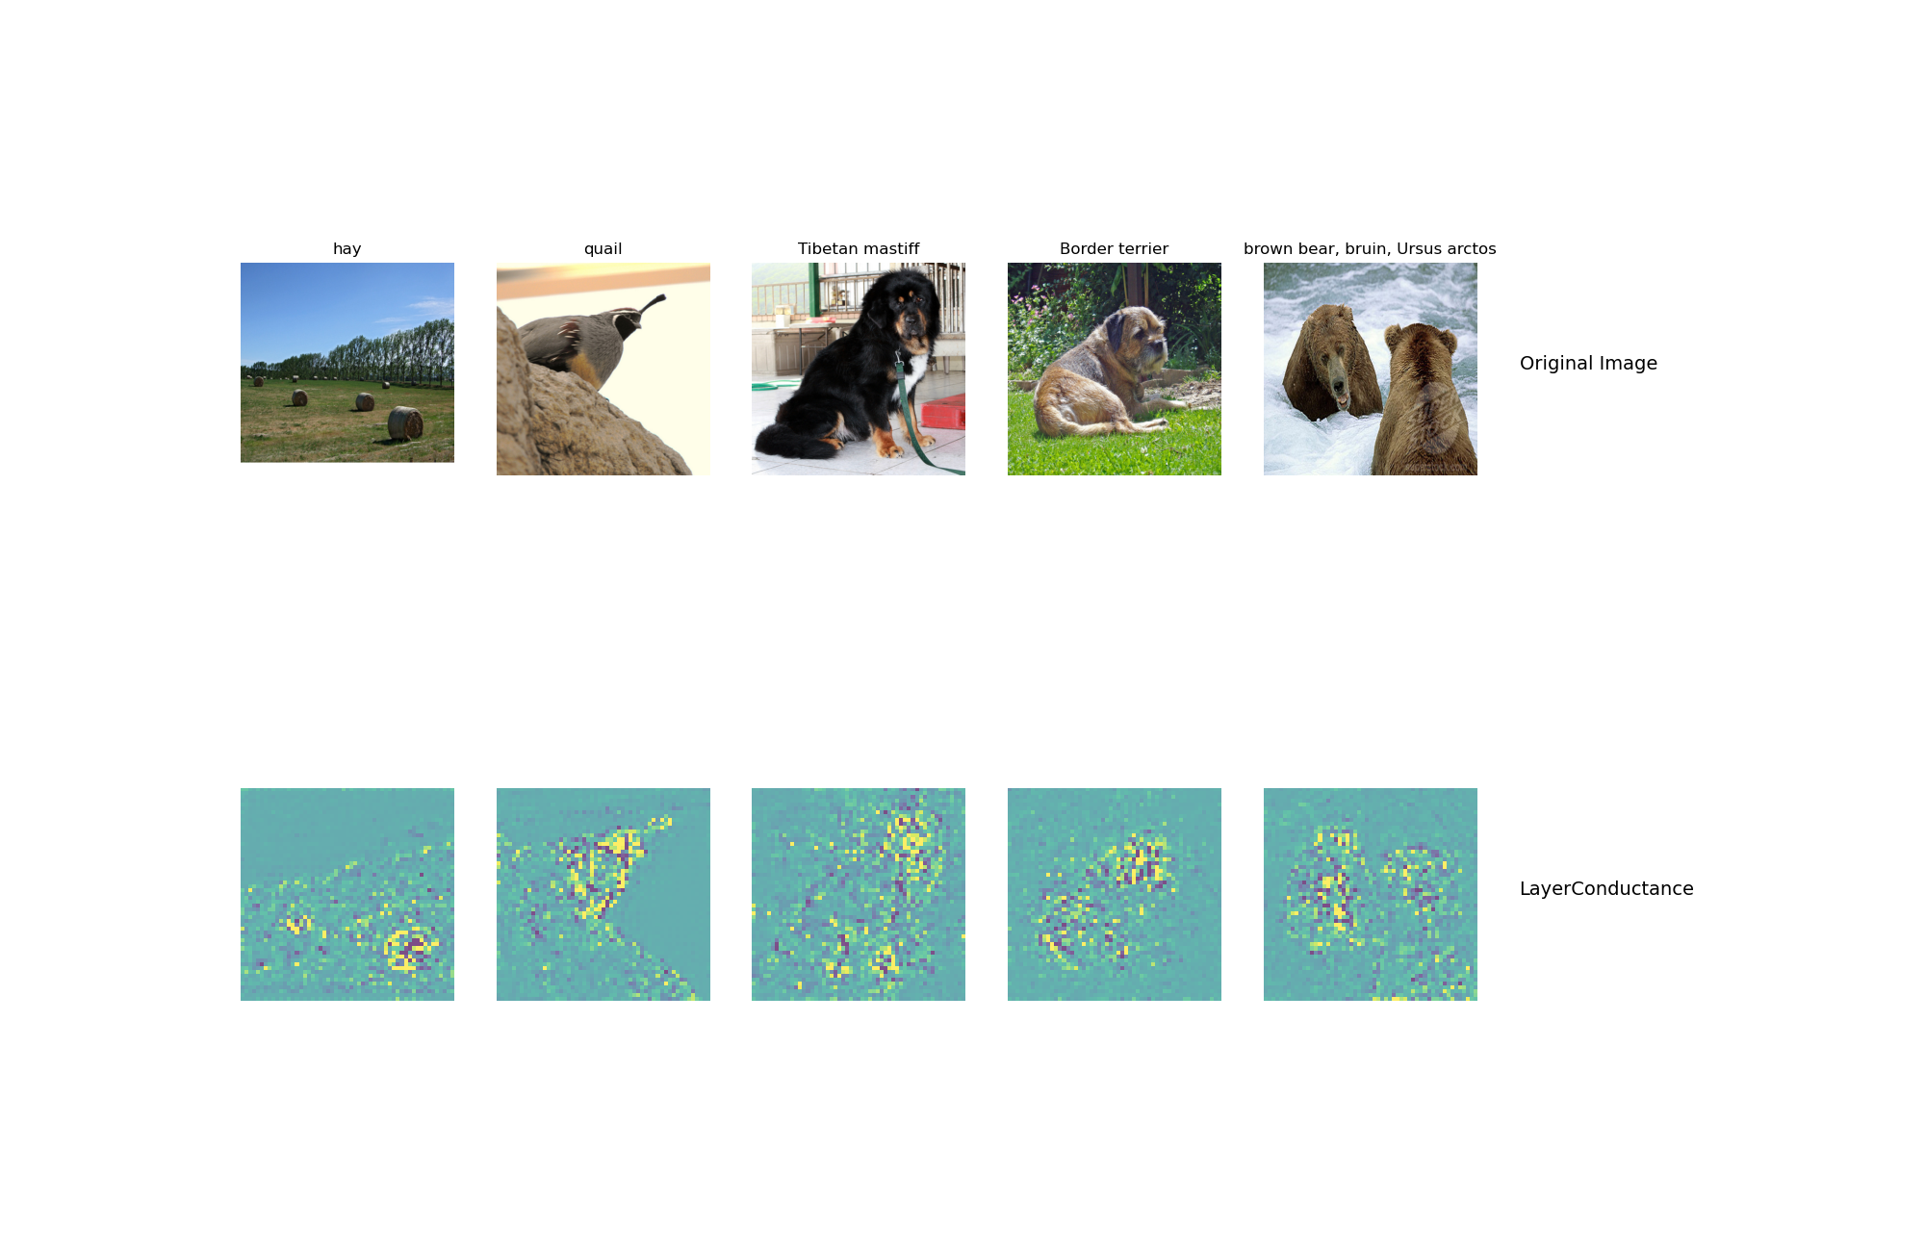
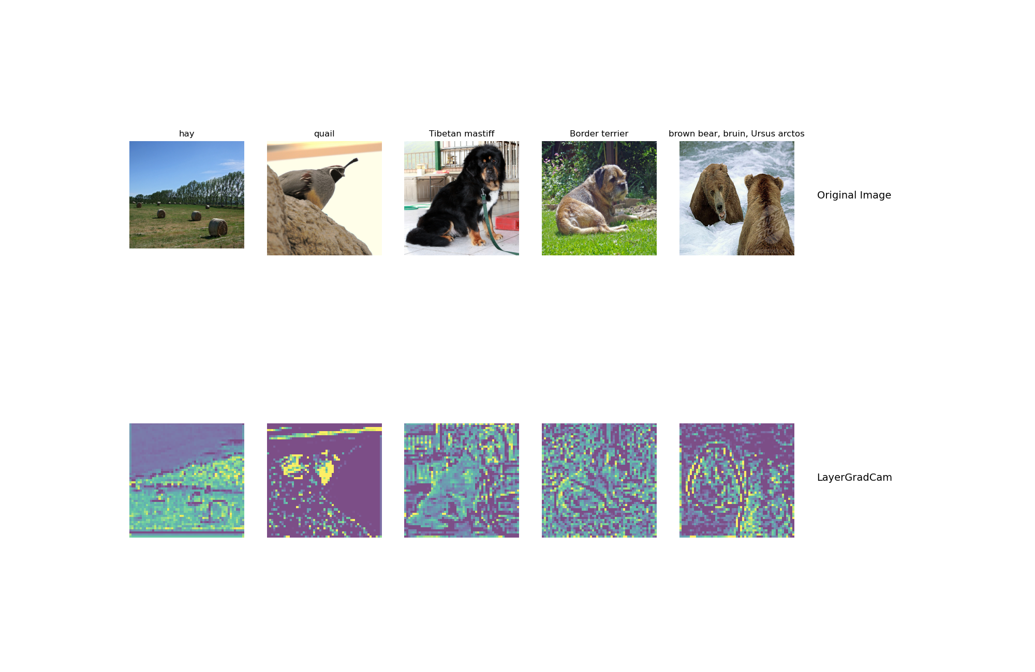
Layers and neurons using Captum (1 point)
Visualization of layers and neurons using Captum here:

Slide 10
What do saliency map and Gradcam tell you? (1 point)
Answer: Saliency map and Gradcam tell you where which inputs/pixels effected the output the most. Typically isolating for positive reinforcement only, it essentially tells you where the network is looking when labeling an image kind of like a heat map. This can be helpful in debugging neural networks in case the network has unintentional biases, like recognizing snowy images as huskies because the data given had a lot of huskies in snow. You would be able to tell because it would put more emphasis on the background than the dog itself.

Slide 11
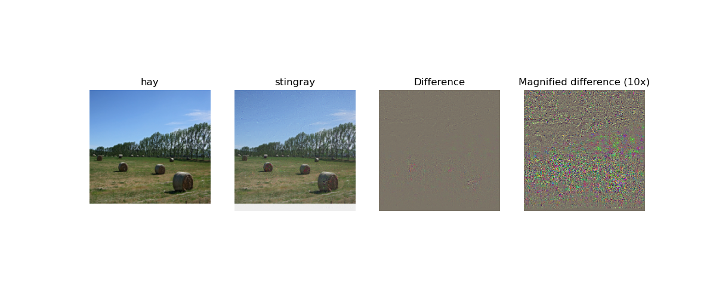
Fooling Image (1 point)
Include the fooling image here

Slide 12
Fooling Image Insights (1 point)
What insights do you get from fooling images:
Answer: Fooling images show the robustness or lack there of in a network. They demonstrate how easy it is to fool a network with what appears to be arbitrary data. As a generative adversarial attack, fooling images provide us a glimpse into what the network’s intuition of a class is. Likewise, the code is very similar to that of class visualization as well.

Slide 13
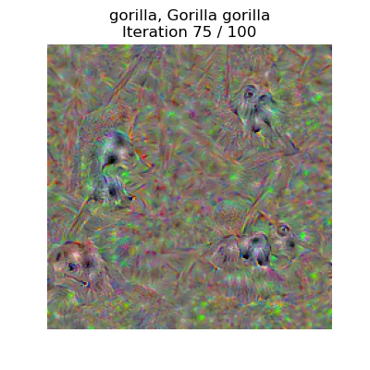
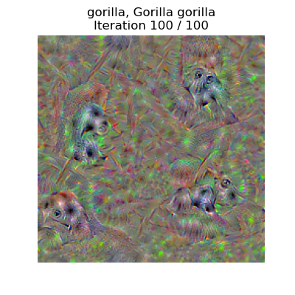
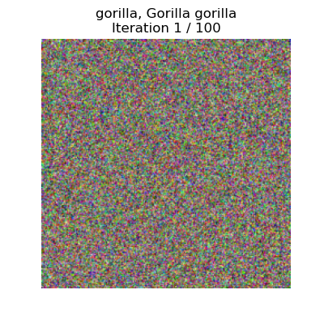
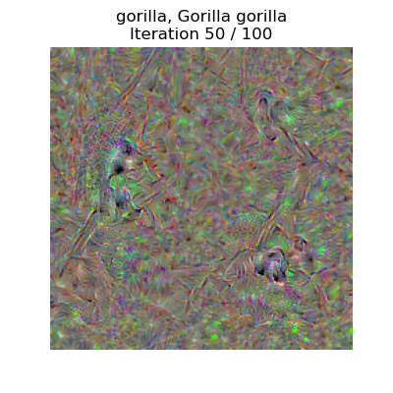
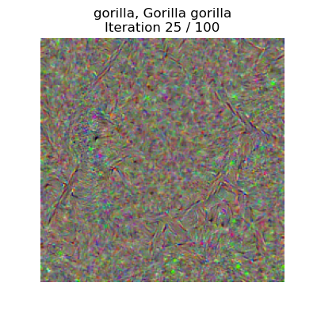
Class Visualization (3 points)
Include class visualizations here

Slide 14
Style Transfer

Slide 15
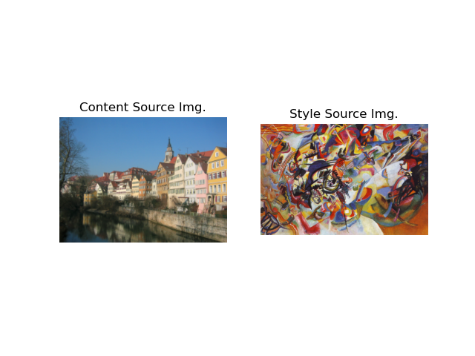
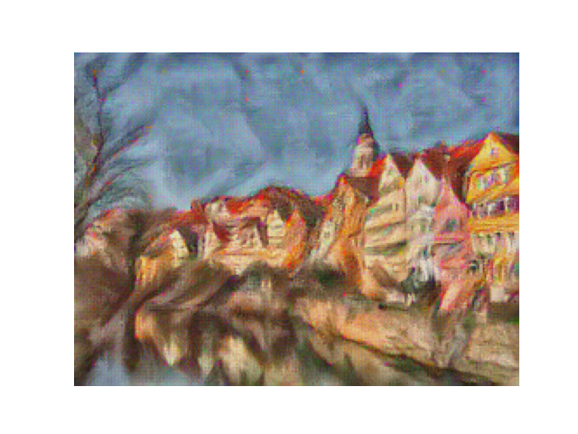
Composition VII + Tubingen (1 point)
Include both original images and the transferred image

Slide 16
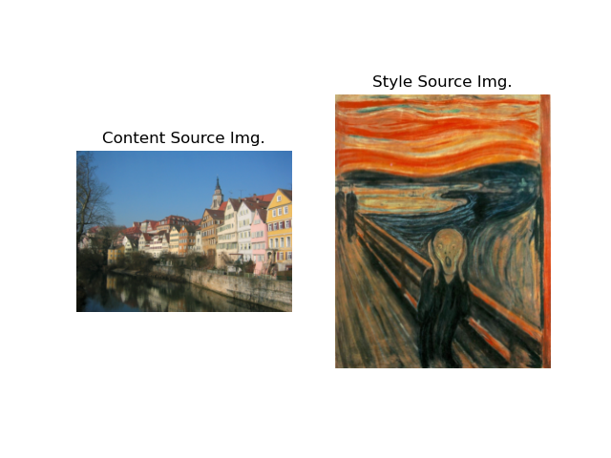
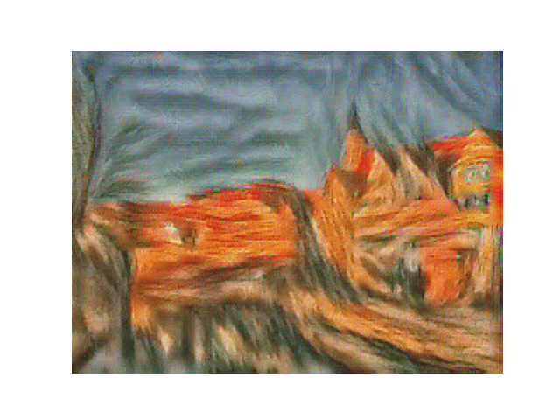
Scream + Tubingen (1 point)
Include both original images and the transferred image

Slide 17
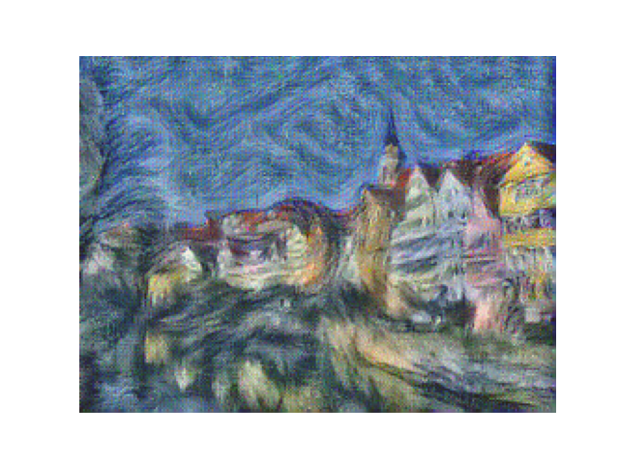
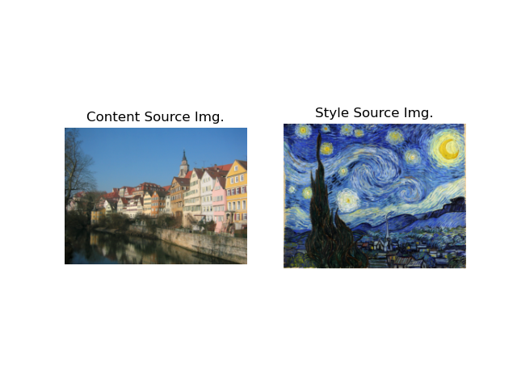
Starry Night + Tubingen (1 point)
Include both original images and the transferred image

Slide 18
Be sure to append the jupyter notebook i.e. $root/test_style_transfer.ipynb for testing sections of the style transfer implementation to this report. (4 points)

